Slide 1
Problems

Slide 2
Types of Computer
There are many different types of computer:
general purpose - PCs, Laptops etc
specialised - servers, routers,microcontrollers

Slide 3
Functions
In general computers can do four things:
Input (accepts data)
Processing (processes data)
Output (produces output)
Storage (save results)

Slide 4
Example
Using one specific computing device (i.e. your smartphone) give examples of these four functions in action:
Type of Computer: Calculator
1.It accepts numbers you enter
2.It processes data by way of solving equations
3.If the equation is inputted correctly it outputs an answer
4.It saves equations that you have previouly entered

Slide 5
Why Computers?
What advantages/disadvantages are there when using a computer for a task, compared to a human?
(list as many reasons as you can)
Advantages: Can perform many tasks at the same time, Computers can work much faster and more reliably than a human,
Disadvantages: A computer cannot be creative, They cannot notice things that they have not been programmed to measure. They can carry out commands, and only that.

Slide 6
List some Apps that are used for...
Storing of information
Google drive, facebook, iCloud, Gmail

Slide 7
List some Apps that are used for...
Retrieving information
Google Chrome, Mozilla Firefox, Internet explorer, Safari

Slide 8
List some Apps that are used for...
Sending or communicating information
Gmail, Facebook, Twitter, Google+,

Slide 9
List some Apps that are used for...
Modifying or transforming information.
Photoshop, Microsoft Excel,

Slide 10
Hardware/Software
What is the difference between hardware and software?hardware is any physical device used in or with your machine, whereas software is a collection of code installed onto your computer's hard drive.

Slide 11
What are the following for?
CPU Central Processing Unit
GPU Graphic Processing Unit
RAM Random Access Memory
Motherboard is the main printed circuit board (PCB) found in computers and other expandable systems.
Hard Drive A hard drive is a data storage device used for storing and retrieving digital information

Slide 12
Software I
What is an operating system (OS) ? List some variants.
The low-level software that supports a computer's basic functions, such as scheduling tasks and controlling peripherals.
Eg. Real-time operating system, Single-user, single task, Single-user, multi-tasking, Multi-user

Slide 13
Software II
In relation to computer software, what are drivers?A driver is software that allows your computer to communicate with hardware or devices.

Slide 14
Networks
What do computer networks allow us to do?allows computers to exchange data
What is the difference between the world wide web (www) and the internet?
The internet is a global computer network providing a variety of information and communication facilities, consisting of interconnected networks using standardized communication protocols.
The World Wide Web,is a way of accessing information over the medium of the Internet. It is an information-sharing model that is built on top of the Internet.

Slide 15
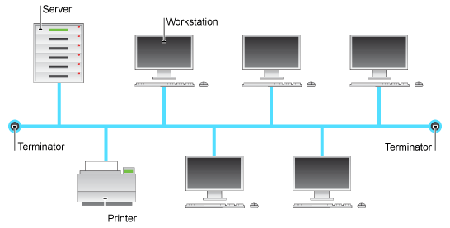
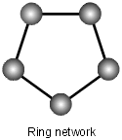
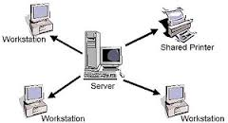
Network Topologies
What do the following network configurations look like?
Ring
Star
Bus
Ring Star Bus
Which configuration do you think this lab uses? Bus

Slide 16
Acronyms
Explain:
LAN Local area network
WAN Wide area network
MAN Metropolitan Area Network

Slide 17
Protocols
A protocol is simply an agreed way of doing things. For instance, social protocol dictates that if someone greets you with “Dia duit” you reply with “Dia is Muire duit”
Computers have similar - albeit more robust - communication protocols.

Slide 18
What are these Protocols for?
SMTP/POP3 Mail Delverery
FTP Transferring files from one host to another
TCP/IP It enables Windows-based computers to connect and share information with other Microsoft and non-Microsoft systems.

